Slide 1

Machine Learning Algorithm using Python
Course Introduction
Dr. Mahesh Ramalingam
Assistant Professor & Area Chairperson
Analytics & IT, IMT Hyderabad

Slide 2

Dr. Mahesh Ramalingam
Assistant Professor & Area Chairperson
Analytics & IT, IMT Hyderabad
Education
Ph. D from University of Hyderabad
MBA from Pondicherry University
Teaching Interest
Programming for data science
Big Data analytics
Machine Learning Algorithm
Deep Learning
Visual Analytics
Blockchain for Managers
Research Interest
Service Quality
Customer Experience
Green Marketing
Corporate Social Responsibility
Big data
Qualitative Research

Slide 3
Course Handout

Slide 4
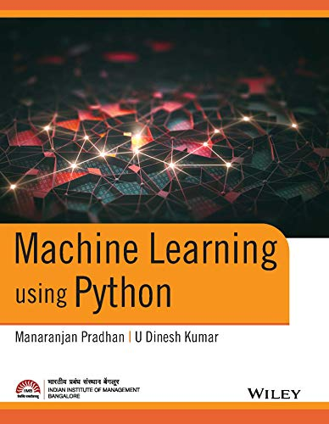
Textbook

Slide 5

Software

Slide 6
Who Should Take This Course?
This course will be a good fit for you, if you
are interested in understanding the fundamentals of ML
want to do research in ML or related areas
are comfortable with statistics
This course will NOT be a good fit for you, if you
want to learn deep learning
are mostly interested in implementing ML algorithms
are not comfortable with statistics

Slide 7
Learning Objective, Emphases and Expectations
A solid understanding of the theoretical foundation of machine learning
The ability to analyze and apply machine learning models and algorithms
Mostly theoretical approaches and formal proofs, and a little implementation

Slide 8


Hardware Requirements
Laptop with Extended Monitor
Highspeed Broadband connection

Slide 9

Lecture Slides
Lecture slides will be posted on the MS Team
Complete slides will be posted after class.

Slide 10
Keys to Success
Come to class
Do the assignments
Read the textbook
Do lots of practice problems

Slide 11
Do’s and Don’ts concerning to online classes
Do join the class, before the actual scheduled timing and logout (end class) after the session is over.
Restart your laptop/PC every day to access the online sessions more effectively
Don’t blame a late submission of an assignment on technical ground.
Sharing the session link with other students isn’t permissible
Sharing the course content/material among other students or on digital platforms is strictly prohibited.
Sharing of the video/recorded sessions among other students or on digital platforms is strictly prohibited
Recording of online sessions by some application or other devices is also strictly prohibited
Do not accept the default notification of class schedule sent by Microsoft Teams

Slide 12



Slide 13
What is Learning ?
Using Experience
to gain Expertise

Slide 14
Why do we need Machine Learning?
Tasks that are too complex to program
Computer vision: we know to detect objects but have no idea how we do it
Search engines: a human can’t read the entire internet
Adaptivity and speed of development

Slide 15
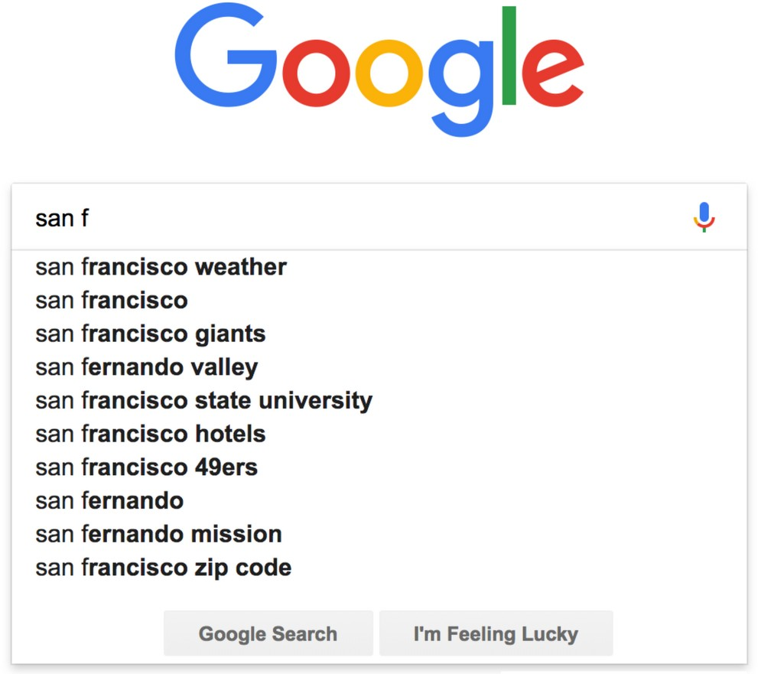
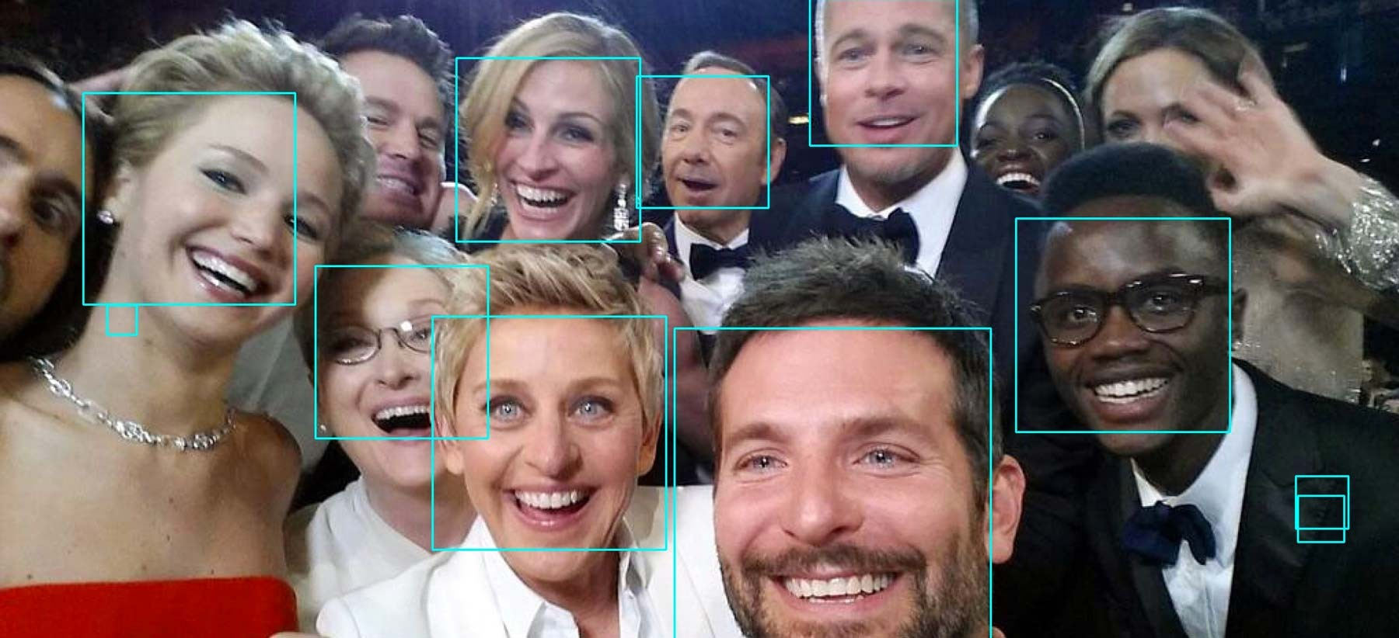
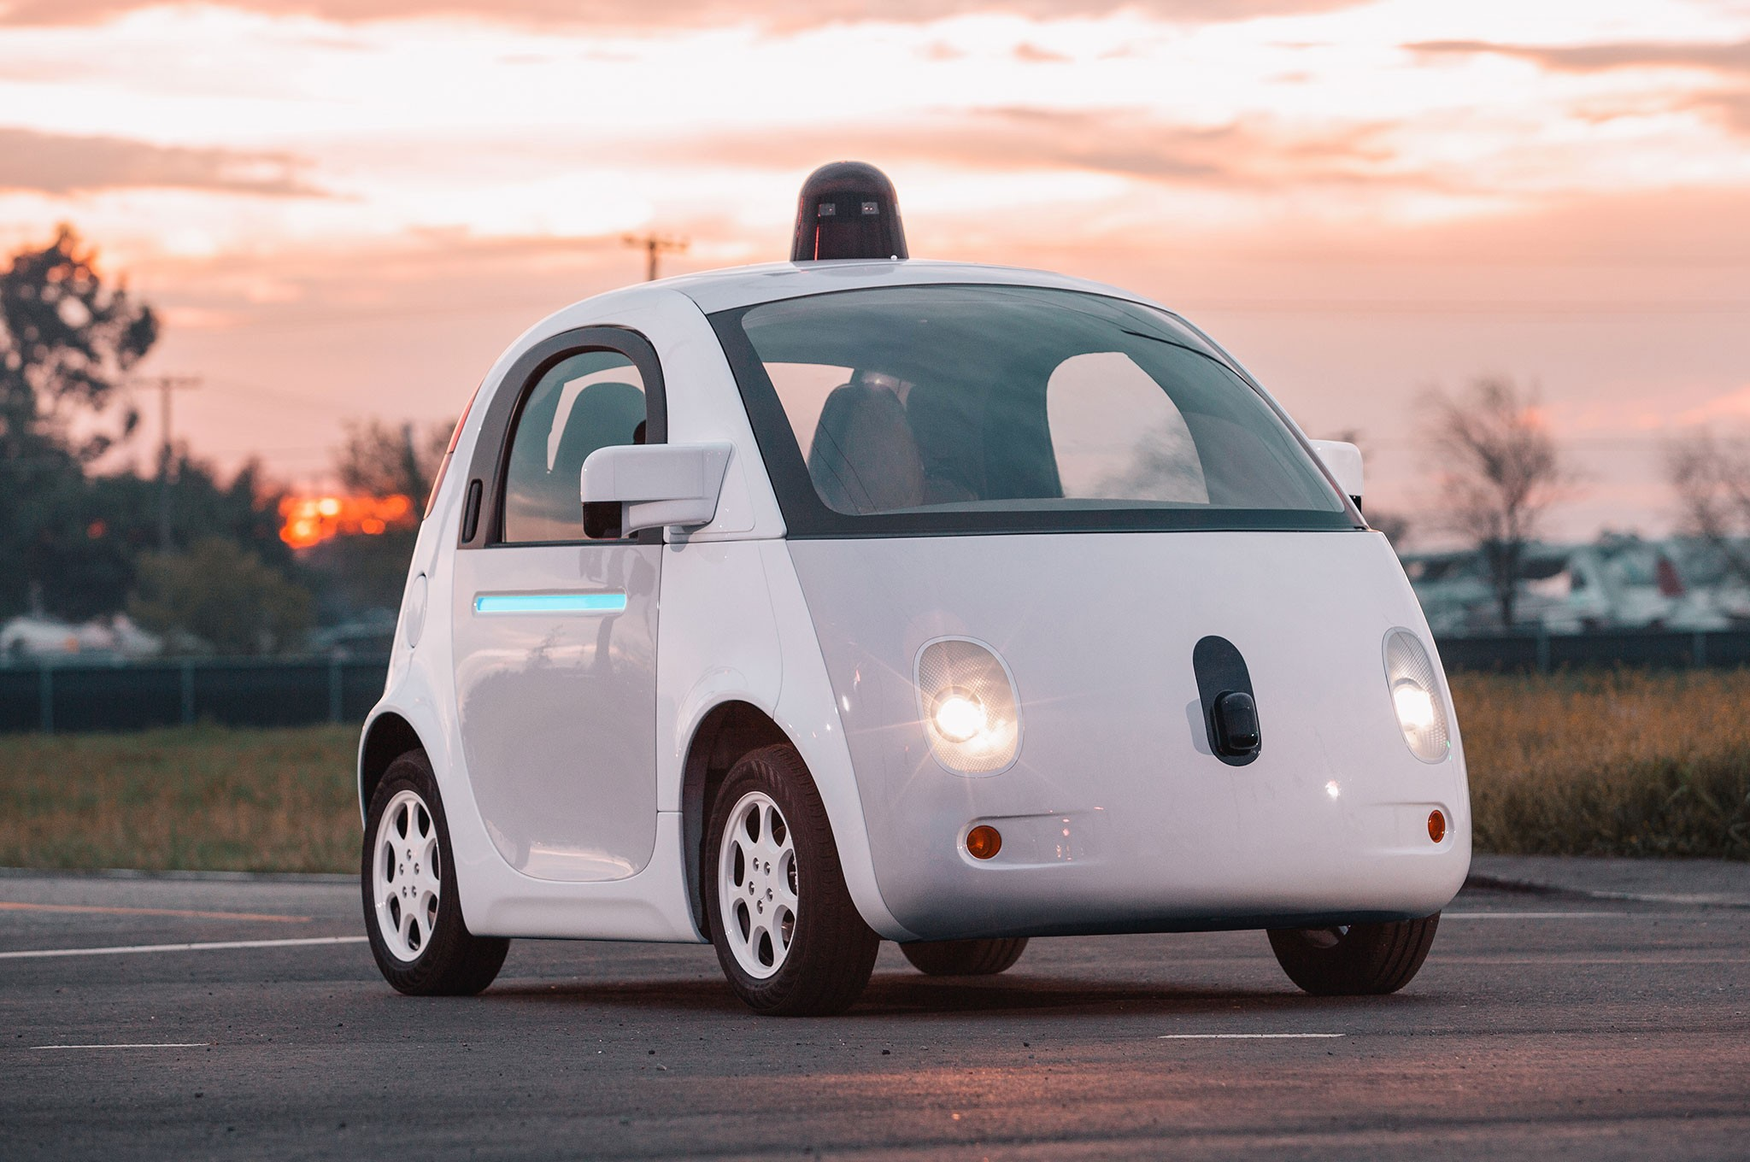

What Is Machine Learning?
Machine learning is: the study of methods that improve their performance on some task with experience

Slide 16









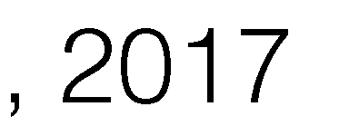
What Is Machine Learning?

Slide 17
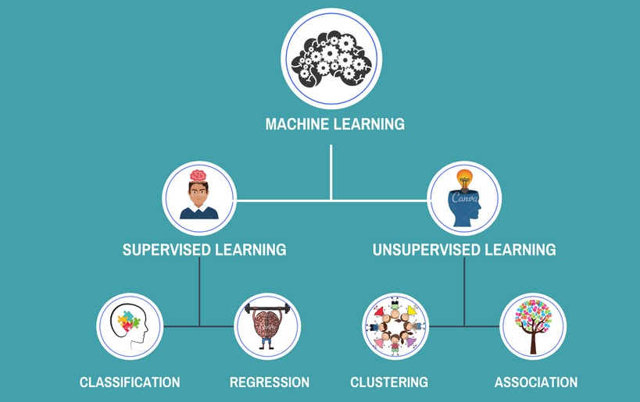

Slide 18
Machine Learning Pipeline
data
ML method
intelligence
... well, maybe not real intelligence, but since these terms are poorly defined, we’ll use the term intelligence for this lecture.

Slide 19





Task 1: Regression
How much should you sell your house for?
data
ML method
intelligence
pirce ($)
= ??
house size
input: houses & features
learn: x → y relationship
predict: y (continuous)
Course Covers: Feature Scaling, Linear/Ridge Regression, Loss Function, SGD, Regularization, Cross Validation
9

Slide 20










Task 2: Classification
Cat or dog?
data
ML method
intelligence
= ??
input: cats and dogs
learn: x → y relationship
predict: y (categorical )
Course Covers: Naive Bayes, Logistic Regression, SVMs, Neural Nets, Decision Trees, Boosting, Nearest Neighbors

Slide 21


Task 3: Clustering
How to segment an image?
data
ML method
intelligence
input: raw pixels {x}
separate: {x} into sets
output: cluster labels {z}
Course Covers: K-means, K-means++, Gaussian Mixture Model (GMM) clustering

Slide 22
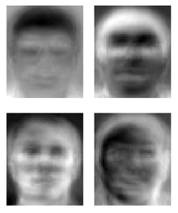
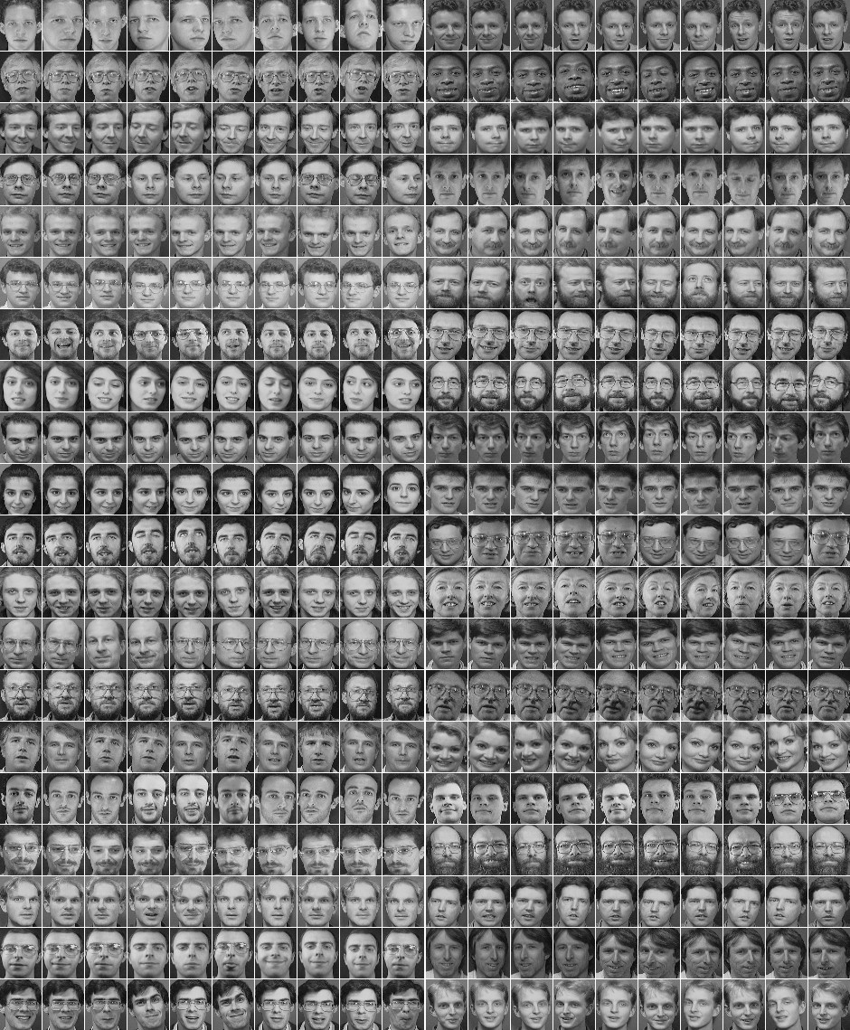
Task 4: Embedding or representation
How to reduce size of dataset?
data
ML method
intelligence
input: large dataset {x}
find: sources of variation
return: representation {z}
Course Covers: Dimensionality Reduction, Principal Component Analysis (PCA)

Slide 23
Goal of the Course
data
ML method
intelligence
feature extraction
model & parameters
optimization
evaluation
Equip you with the tools to develop and deploy machine learning for business applications
Fundamental Understanding: Algorithms, Theoretical Analysis
Applications: Implementation in Python

Slide 24
Key Topics
Models
Linear regression
Linear classification: logistic regression, SVM
Nearest neighbors, clustering
Methods
Gradient descent
Boosting
k-means
PCA
Concepts
Point estimation, MLE, MAP
Loss functions, bias-variance tradeoff,
cross-validation
Sparsity, overfitting, model selection
Types of ML (supervised, unsupervised, reinforcement)

Slide 25
What is Machine Learning?
“Learning is any process by which a system improves performance from experience.”
-Herbert Simon
Definition by Tom Mitchell (1998):
Machine Learning is the study of algorithms that
improve their performance P
at some task T
with experience E.
A well-defined learning task is given by <P, T, E>.

Slide 26
Traditional Programming
Data Program
Computer
Output
Machine Learning
Data Output
Computer
Program

Slide 27
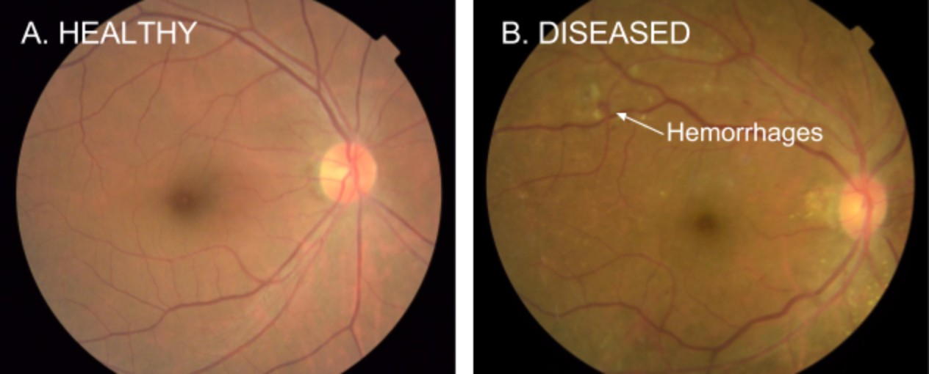
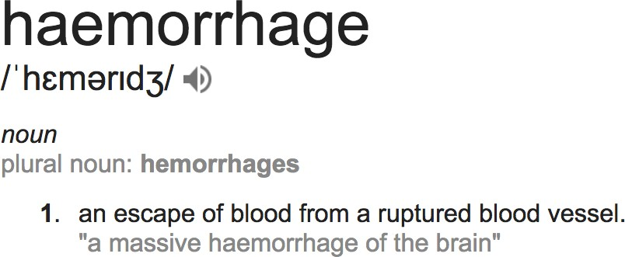
Detection of Diabetic Eye Disease
https://research.googleblog.com/2016/11/deep-learning-for-detection-of-diabetic.html
Google working closely with doctors both in India and the US, created a development dataset of 128,000 images which were each evaluated by 3-7 ophthalmologists from a panel of 54 ophthalmologists.
Trained a deep neural network to detect referable diabetic retinopathy.
Then tested the algorithm’s performance on two separate clinical validation sets totaling ~12,000 images, with the majority decision of a panel 7 or 8 U.S. board-certified ophthalmologists serving as the reference standard.
the algorithm has a F-score (combined sensitivity and specificity metric, with max=1) of 0.95, which is slightly better than the median F-score of the 8 ophthalmologists we consulted (measured at 0.91).

Slide 28
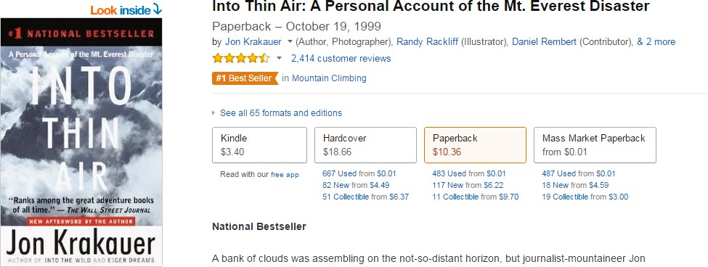

Customers who bought this item also bought…

Slide 29
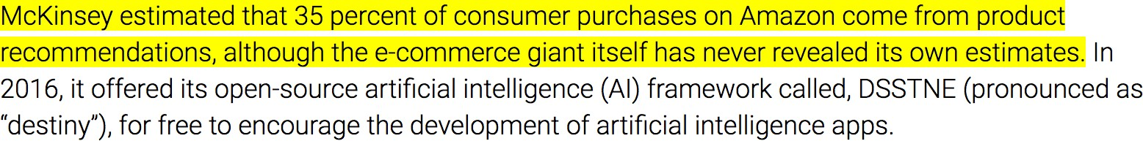
Recommendations are key to personalization
https://martechtoday.com/roi-recommendation-engines-marketing-205787

Slide 30
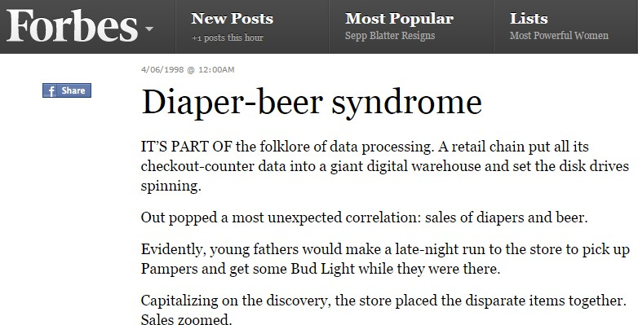
What customers bought together

Slide 31

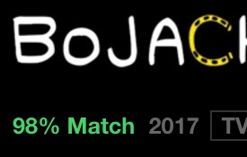



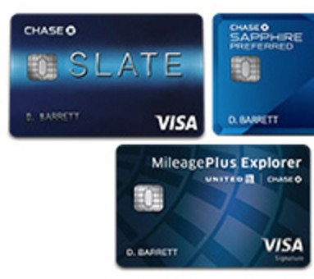

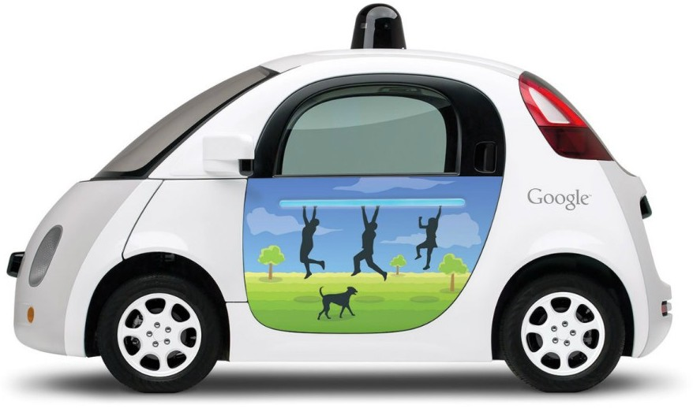

personalized predictions are made by learning from past data
You may also like…

Slide 32


Slide 33
Lifecycle
Use Case Identification and Problem Formulation
Data Extraction and Preparation
Exploratory Analysis & Feature Engineering
Building Machine Learning Models
Model Validation and Evaluation
Model Deployment
Iterative Steps

Slide 34
What Tools are available?

Slide 35
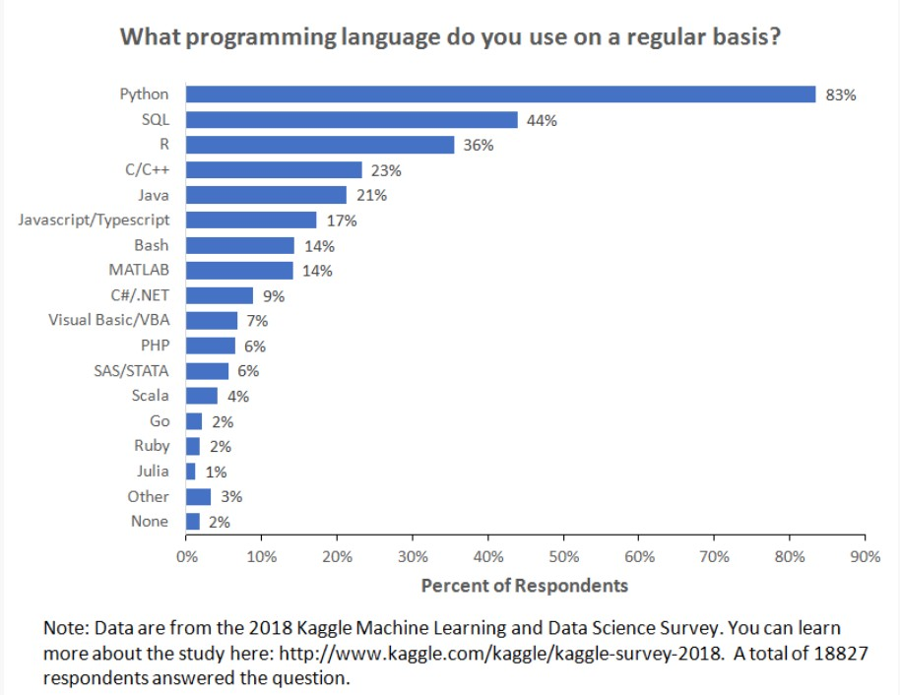
Language for Machine Learning
https://businessoverbroadway.com/2019/01/13/programming-languages-most-used-and-recommended-by-data-scientists/

Slide 36

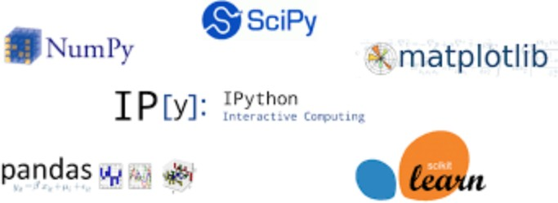
Python Stack For Data Science
Efficient storage of arrays and matrices. Backbone of all scientific calculations and algorithms.
Library for scientific computing.
Linear algebra, statistical computations, optimization algorithm.
Plotting and visualization
High-performance, easy-to-use data structures for data manipulation and analysis. Pandas provide the features of dataframe, which is very popular in the area of analytics for data munging, cleaning & transformation.
IDE or Development environment for data analysis in python.
Machine learning library. Collection of ML algorithms.

Slide 37
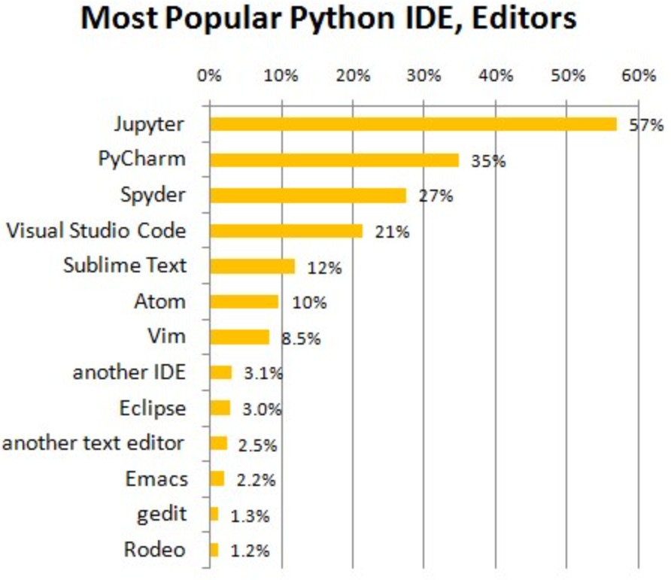
Language for Machine Learning
https://www.anaconda.com/download/

Slide 38
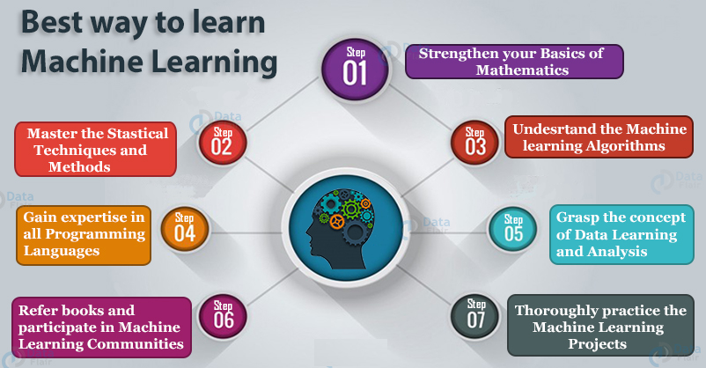

Slide 39
Types of machine learning tools
3
Reinforcement Learning
Prescriptive Analytics
Enabling smart decisions
based on data
What should we do?
Optimization and decision making
MLA
Supervised Learning
2
1
Unsupervised Learning
Predictive analytics
Descriptive analytics
Predicting the future based on historical patterns
What could happen?
Mining data to provide
business insights
What has happened?

Slide 40
Types of machine learning
 | Supervised Learning | Unsupervised Learning | Reinforcement Learning
Goal | Predict …from examples | Describe ...structure in data | Strategize learn by trial and error
Data | (𝑥, 𝑦) | 𝑥 | delayed feedback
Types | Classification Regression | Density estimation Clustering Dimensionality reduction Anomaly detection | Model-free learning Model-based learning

Slide 41
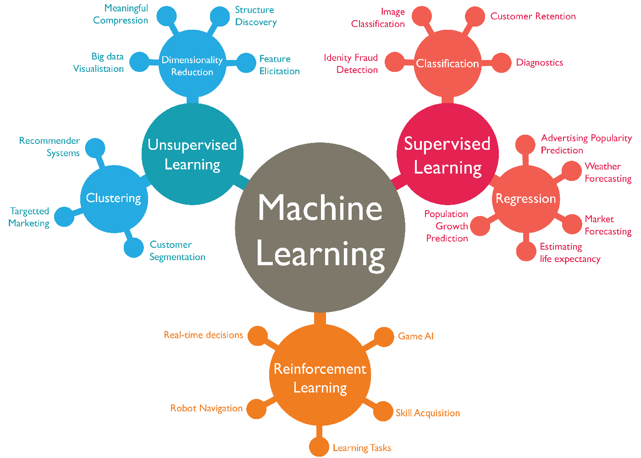

Slide 42
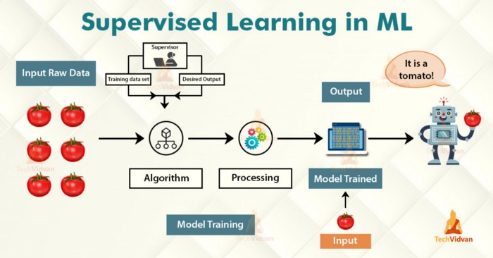

Slide 43
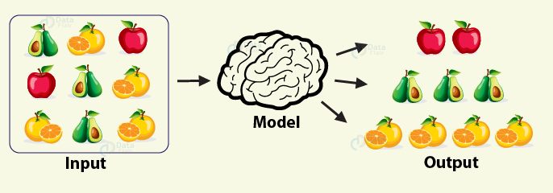
Unsupervised Learning

Slide 44
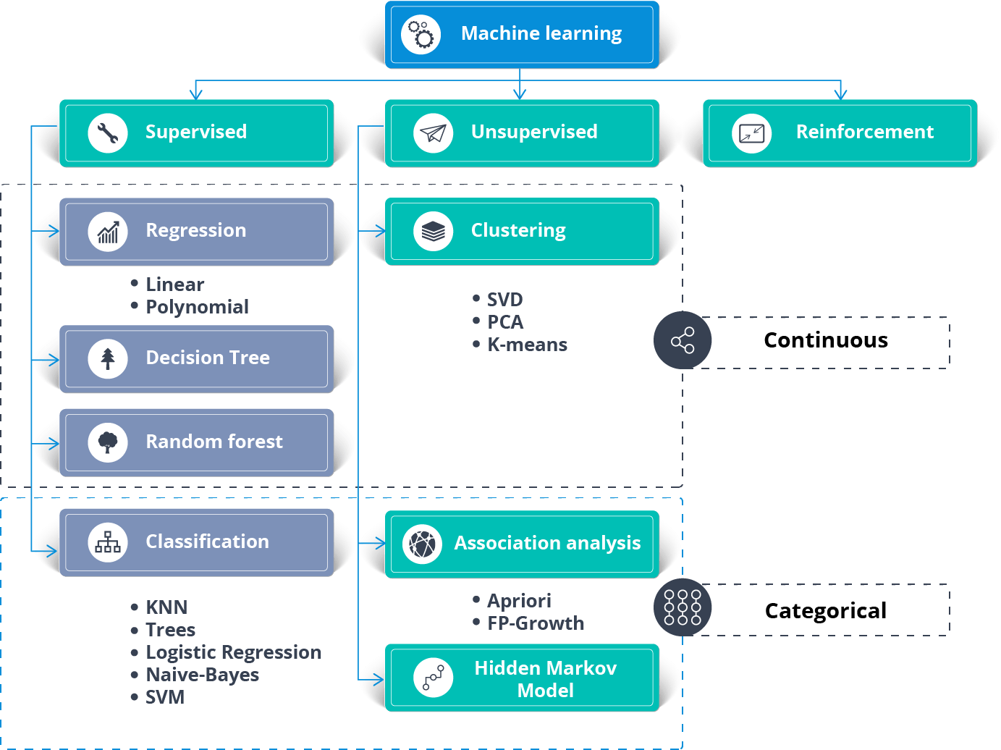

Slide 45
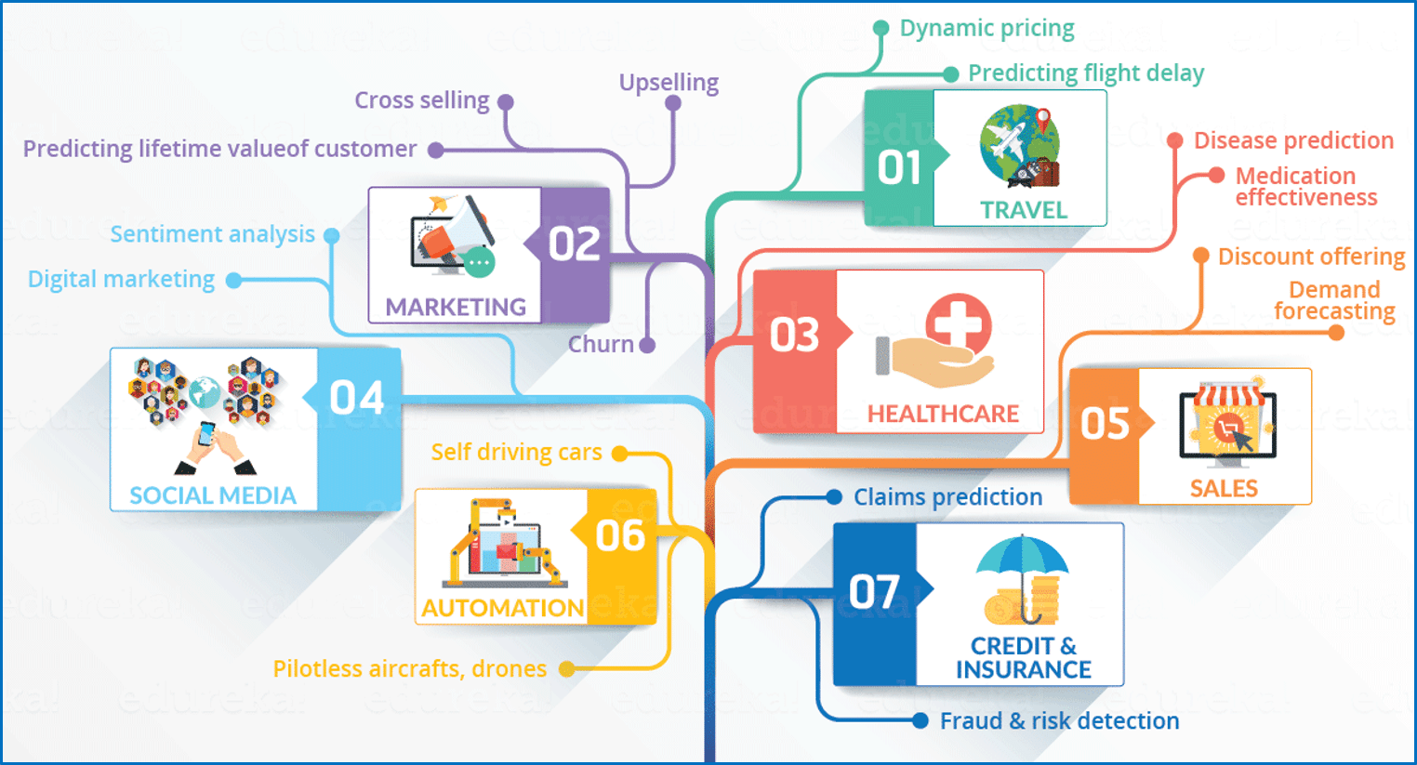

Slide 46
Top Machine Learning Algorithms
Linear Regression
Logistic Regression
Decision Trees
Naive Bayes
Artificial Neural Networks
K-means Clustering
Anomaly Detection
Gaussian Mixture Model
Principal Component Analysis
KNN
Support Vector Machines

